Slide 1
Topic 4: Pointers, Command line arguments, Streams
CAB202 – Microprocessors and Digital Systems
Unit Coordinator: Luis Mejias Alvarez
Lecturer: Lawrence Buckingham

Slide 2
References

Slide 3
Practical C Programming
Chapter 13 – Pointers
Chapter 14 – File Input/Output
CPlusPlus.com Pointer Tutorial
Devdocs.io/c/io
CPlusPlus.com Reference stdio.h

Slide 4
Pointers

Slide 5
What's a pointer
A value that tells us where to find an object in memory at run time.
A kind of integer.
Interpreted as the address of an object.
Used to send arrays to functions.
Used to send the address of an object to functions where we need to put data into the object.
"Pass by reference"

Slide 6
Pointer's value is an address
Everything that resides in memory at run time occupies some particular set of continuous memory cells.
Each memory cell has an address.
We can think of the computer's memory as being an array of bytes.
The address of an object is the index of the first byte of the object in the memory array.
We can use the prefix & operator get the address of any object.
Pronounced "address-of"

Slide 7
Pointer's type is "Pointer to X"
Where X is the type of the object pointed at.
Example:
int x = 812; int *p = &x;
x is an int, with initial value 812 p is a pointer to int, with initial value equal to the address of x. *p is an int, with value that is always equal to the value of x (until we change p)

Slide 8
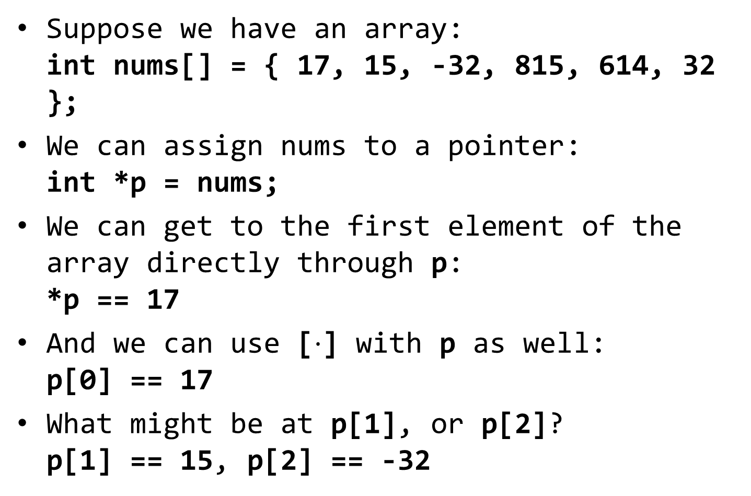
Array notation and pointers
Suppose we have an array: int nums[] = { 17, 15, -32, 815, 614, 32 };
We can assign nums to a pointer: int *p = nums;
We can get to the first element of the array directly through p: *p == 17
And we can use [$⋅$] with p as well: p[0] == 17
What might be at p[1], or p[2]? p[1] == 15, p[2] == -32

Slide 9
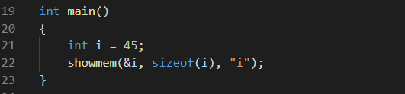
Example
Get the address of variable i
Where it is
Get the size of variable i
How big it is
Measured in bytes
Send both to a function called showmem

Slide 10
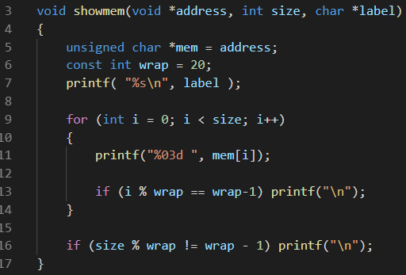
showmem displays the contents of memory

Slide 11
showmem parameters:
address is pointer to "anything"

Slide 12
showmem parameters:
size is an int

Slide 13
showmem parameters:
label is a string

Slide 14
showmem parameters:
mem: pointer to byte, at address

Slide 15
showmem parameters:
Declare a constant that we use later.

Slide 16
showmem parameters:
Print the label

Slide 17
showmem parameters:
Use a loop to traverse the memory

Slide 18
showmem parameters:
Display the value of a single byte

Slide 19
showmem parameters:
If counter is one less than a multiple of wrap, advance to new line

Slide 20
showmem parameters:
Keep doing this until all bytes have been displayed

Slide 21
showmem parameters:
Finally, advance to new line if didn't already do that

Slide 22
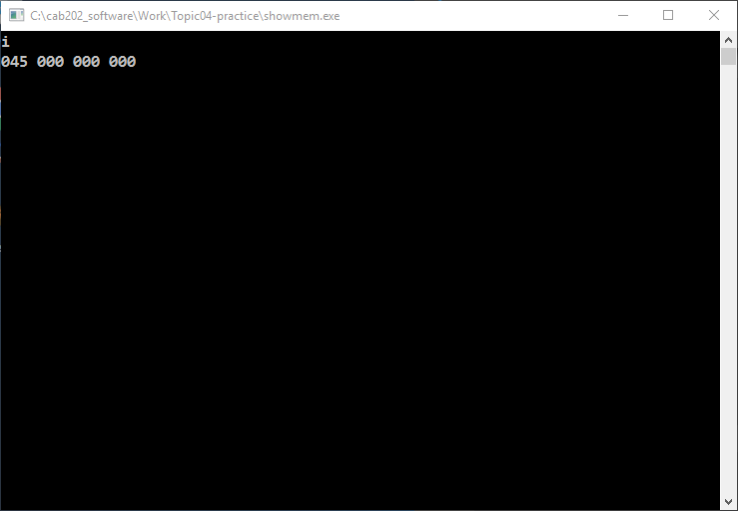
When showmem runs
Variable i occupies 4 bytes; three of them have zeroes.

Slide 23
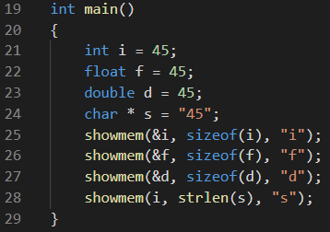
Look at some other variables
Add a float, a double, and a string.
When we show the string, don't take the address, and use strlen instead of sizeof.
sizeof does not work for strings

Slide 24
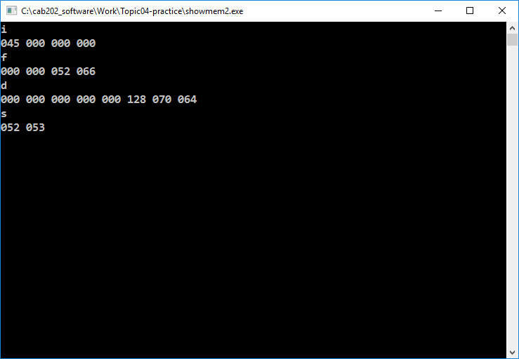
When showmem2 runs
Variable i still occupies 4 bytes; three of them have zeroes.

Slide 25
When showmem2 runs
Variable f is the same size as i, but the data is completely different.

Slide 26
When showmem2 runs
And d is bigger, with yet another completely different data layout.

Slide 27
When showmem2 runs
While s contains two ASCII codes, '4' and '5'.

Slide 28
Using pointers to insert data into variables
Send the address of a variable to a function if you want the value of the variable to change during the function call.
Especially useful if you need to return multiple results from a function.
Seen this already with scanf.

Slide 29
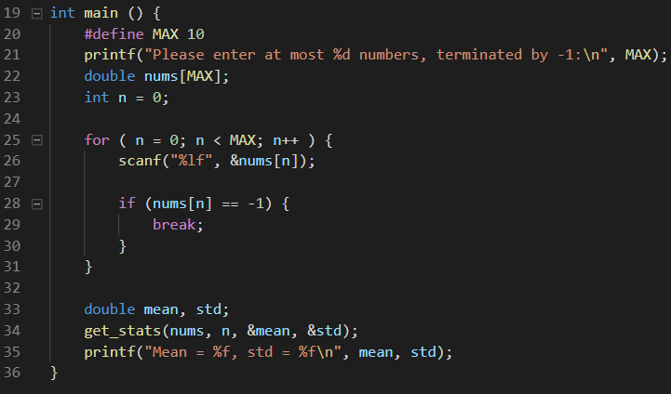
Example: compute mean and std dev

Slide 30
The interesting part in main...
Declare two local variables: mean, std. Send their addresses to get_stats

Slide 31
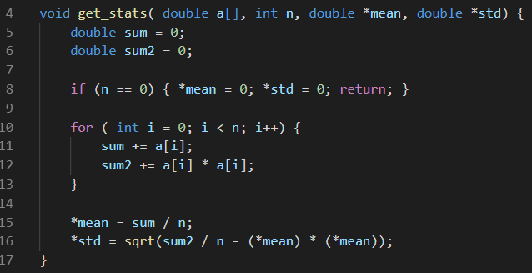
get_stats
Here, mean and std are pointers to double.

Slide 32
get_stats
To get to their double value, dereference: *mean is a double, *std is a double.

Slide 33
get_stats
To get to their double value, dereference: *mean is a double, *std is a double.

Slide 34
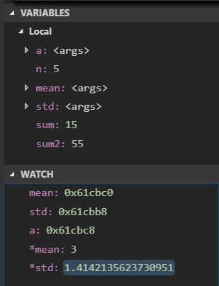
When get_stats runs...
You can use the Watch Window to reveal the value of pointers, and the objects they point at:
mean - a hexadecimal address
*mean - a decimal formatted floating point value.

Slide 35
Command line arguments

Slide 36
Secret parameters for main
The main function accepts parameters
A more complete declaration of main is: int main (int argc, char *argv[])
Interpretation:
argc is an int, which tells us how many valid elements there are in argv
argv is an array of strings
Sometimes you see it written as char **argv -- equivalent.

Slide 37
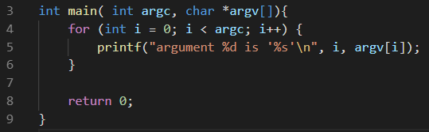
Example: echo_args.c
Traverse the command line argumetns and echo them to standard output stream.

Slide 38
When echo_args runs
Lawrence@WIN-HK5JCU2LBGD /cygdrive/c/cab202_software/Work/Topic04-practice
$ ./echo_args
argument 0 is './echo_args'
Lawrence@WIN-HK5JCU2LBGD /cygdrive/c/cab202_software/Work/Topic04-practice
$ ./echo_args one two three
argument 0 is './echo_args'
argument 1 is 'one'
argument 2 is 'two'
argument 3 is 'three'
Lawrence@WIN-HK5JCU2LBGD /cygdrive/c/cab202_software/Work/Topic04-practice
$ ./echo_args "one two three" four "five six seven"
argument 0 is './echo_args'
argument 1 is 'one two three'
argument 2 is 'four'
argument 3 is 'five six seven'

Slide 39
When echo_args runs
Lawrence@WIN-HK5JCU2LBGD /cygdrive/c/cab202_software/Work/Topic04-practice
$ ./echo_args
argument 0 is './echo_args'
Lawrence@WIN-HK5JCU2LBGD /cygdrive/c/cab202_software/Work/Topic04-practice
$ ./echo_args one two three
argument 0 is './echo_args'
argument 1 is 'one'
argument 2 is 'two'
argument 3 is 'three'
Lawrence@WIN-HK5JCU2LBGD /cygdrive/c/cab202_software/Work/Topic04-practice
$ ./echo_args "one two three" four "five six seven"
argument 0 is './echo_args'
argument 1 is 'one two three'
argument 2 is 'four'
argument 3 is 'five six seven'
argv[0] is the name of the program.

Slide 40
When echo_args runs
Lawrence@WIN-HK5JCU2LBGD /cygdrive/c/cab202_software/Work/Topic04-practice
$ ./echo_args
argument 0 is './echo_args'
Lawrence@WIN-HK5JCU2LBGD /cygdrive/c/cab202_software/Work/Topic04-practice
$ ./echo_args one two three
argument 0 is './echo_args'
argument 1 is 'one'
argument 2 is 'two'
argument 3 is 'three'
Lawrence@WIN-HK5JCU2LBGD /cygdrive/c/cab202_software/Work/Topic04-practice
$ ./echo_args "one two three" four "five six seven"
argument 0 is './echo_args'
argument 1 is 'one two three'
argument 2 is 'four'
argument 3 is 'five six seven'
"proper" arguments appear at 1, 2, ... (argc-1).

Slide 41
When echo_args runs
Lawrence@WIN-HK5JCU2LBGD /cygdrive/c/cab202_software/Work/Topic04-practice
$ ./echo_args
argument 0 is './echo_args'
Lawrence@WIN-HK5JCU2LBGD /cygdrive/c/cab202_software/Work/Topic04-practice
$ ./echo_args one two three
argument 0 is './echo_args'
argument 1 is 'one'
argument 2 is 'two'
argument 3 is 'three'
Lawrence@WIN-HK5JCU2LBGD /cygdrive/c/cab202_software/Work/Topic04-practice
$ ./echo_args "one two three" four "five six seven"
argument 0 is './echo_args'
argument 1 is 'one two three'
argument 2 is 'four'
argument 3 is 'five six seven'
args with spaces can be glued together with quotes or double quotes.

Slide 42
Formatted File I/O With Streams

Slide 43
We've been using streams since week 1
Streams are defined in <stdio.h>
The type FILE used in <stdio.h> is actually more general then physical files on disk.
Includes other kinds of sequential character sources and sinks
Terminal, keyboard, pipes
Which is how input and output redirection can work.

Slide 44
Useful functions
fopen - establishes a connection to a stream for reading, writing, or a mixture of these
feof - lets us find out if we have reached the end of an input stream
fscanf - formatted input from stream
fprintf - formatted output to stream
fclose - shuts down a connection to a stream
flushes any unwritten data to output stream

Slide 45
fopen
FILE * fopen ( const char * filename, const char * mode );
filename: string containing path of file
mode: string, file access mode.
Probably only need to use "r" in CAB202.
http://www.cplusplus.com/reference/cstdio/fopen/ for more.
Returns pointer to FILE object if success
Returns NULL if cannot open in requested mode.

Slide 46
feof
int feof ( FILE * stream );
Returns non-zero after we have attempted to read at or past the end of the available data in the stream.
Typical use: while ( ! feof( mystream ) ) { // read data // process data }

Slide 47
fscanf
int fscanf ( FILE * stream, const char * format, ... );
This is the more general form of scanf
The familiar scanf(format, argument_list) is the same as fscanf(stdin, format, argument_list)
stdin is a FILE * connected to standard input, available automatically

Slide 48
Read char: fscanf "%c"
To read a single character, use %c in the format string, and the address of a char variable in the argument list.
eg: char ch; fscanf(mystream, "%c", &ch);
To skip over any number of blanks, tabs, and newlines, then read the next non-blank character, put a space before %c:
eg: char non_blank; fscanf(mystream, " %c", &non_blank);

Slide 49
Read int: fscanf "%d"
To read a decimal formatted integer, use %d in the format string, and the address of an int variable in the argument list.
eg: int x; fscanf(mystream, "%d", &x);
This automatically skips over blanks, tabs, and new-lines.
For other integer formats, see http://www.cplusplus.com/reference/cstdio/fscanf/

Slide 50
Read double: fscanf "%lf"
To read a double precision floating point value (double, the default floating point data type), use %lf in the format string, and the address of a double variable in the argument list.
eg: double x; fscanf(mystream, "%lf", &x);
This automatically skips over blanks, tabs, and new-lines.
For other floating point formats, see http://www.cplusplus.com/reference/cstdio/fscanf/

Slide 51
Value returned by fscanf (and scanf)
fscanf returns an integer
The number of placeholders that were successfully scanned into their corresponding variables
eg: int a, b, c; char ch; int n = fscanf(mystream, " %c %d %d %d", &ch, &a, &b, &c);
Attempts to skip spaces, then read a single character into ch, followed by three integers, into a, b, and c respectively.
n == 0: nothing read
n == 1: char success only;
n == 2: char, then one int;
n == 3: char, then two ints; etc.

Slide 52
Example:
Formative AMS exercise 4.3 is an excellent example of this functionality.

Slide 53
End

